Slide 1
The Clarke County Confederate Memorial Monument: A Brief History
Maral S. Kalbian, LLC
January 21, 2021

Slide 2
FINDINGS OF RESEARCH
CC Deed Book Z:244 - June 19, 1900
Acts of General Assembly March 1, 1886

Slide 3
THE MONUMENT:
Dedicated July 21, 1900
Association of the Survivors of the Clarke Cavalry (1884)
Donations with help from the Stonewall Chapter of UDC (1897) and JEB Stuart Camp of Confederate Veterans (1891)
Manufactured by Burns & Campbell in Petersburg, Va.
Cost was approximately $1,000
Six granite pieces
Dedication on front of base
Inscriptions on other three sides contain name of those soldiers who died along with their companies

Slide 4
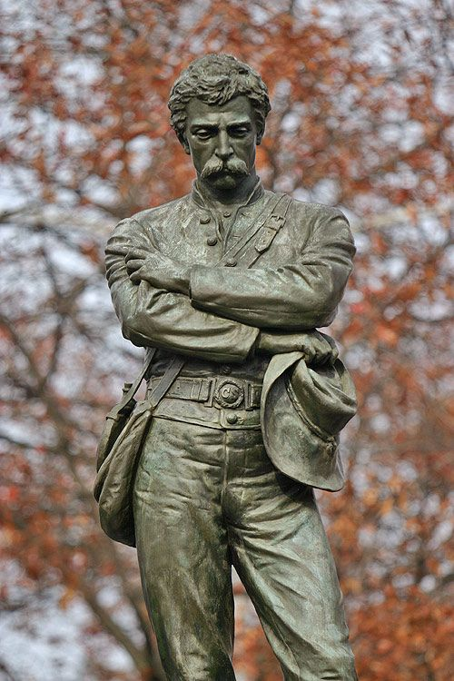
Statue
Painting, sculpture, and statue are known as “Appomattox”
Painting by John Adams Elder of Fredericksburg, Va., 1888
Bronze sculpture by M. Caspar Buberl of NYC 1889
Burns & Campbell in Petersburg, Va., 1900
Most of the Confederate monuments in the Commonwealth that depict soldiers are of bronze with the soldier carrying a rifle
Many were mass produced

Slide 6
The Association of the Survivors of the Clarke Cavalry
Surviving members of the “Clarke Cavalry” Company D, 6th Regiment
Society was formed on August 30, 1884, with the name “the Association of the Survivors of the Clarke Cavalry” (64 members)
March 1, 1886: Act by the General Assembly to incorporate
Hold real estate
Erect a monument
Real estate and funds were tax exempt
Last annual meeting recorded-1918

Slide 7
August 30, 1884
Association of the Survivors of the Clarke Cavalry adopts a resolution to erect a monument to the Confederate dead in Clarke County.
March 1, 1886
Association of the Survivors of the Clarke Cavalry incorporates by an Act of the General Assembly allowing them to hold real estate and be exempt from real estate taxes.
March 1, 1886
The General Assembly authorizes the Clarke County Board of Supervisors to convey part of the "public square in Berryville" to the Association of the Survivors of the Clarke Cavalry to erect a memorial monument.

Slide 8
1886-1887
Association of the Survivors of the Clarke Cavalry raises money for the monument through donations and subscriptions.
1888-1896
No work proceeds due to financial hardships of the time. In 1892, another monument is erected in Old Chapel by the Ladies Memorial Association of Millwood.
August 1897
Association of the Survivors of the Clarke Cavalry forms a new committee to raise funds for a monument to be erected at the Clarke County Courthouse.

Slide 9
1898
Association of the Survivors of the Clarke Cavalry forms a woman's auxiliary committee to help with the fundraising.
1899
Association of the Survivors of the Clarke Cavalry gets help to raise funds from the Stonewall Chapter of the Daughters of the Confederacy and the J.E.B. Stuart Camp of Confederate Veterans.
June 19, 1900
Clarke County Board of Supervisors gifts to the Association of the Survivors of the Clarke Cavalry a circular lot 25 feet in diameter on the "public square" to be used for the purpose of "erecting thereon a memorial monument to their deceased Comrades in Arms."

Slide 10
July 18, 1900
The granite monument arrives in Berryville from Petersburg where it was manufactured by Burns & Campbell. It was transported in six sections, the largest of which weighed six tons.
July 21, 1900
Unveiling of the monument held at the Clarke County Courthouse green. It was reported that 3,000 people attended the day-long ceremony, which included a parade, music, speeches, and banquets.
August 22, 1916
At the 32nd Annual Reunion of the Association of the Survivors of the Clarke Cavalry, they requested that the "Stone Wall Chapter of the UDCs take charge" of the monument when their organization "ceases to exist."

Slide 11
Methodology and Sources
Newspaper articles of the period
Records of the Association of the Survivors of the Clarke Cavalry (1884-1918)
General Assembly Legislative Acts
Clarke County Land Records
Indexes; Deed Books
Clarke County Board of Supervisors Minutes
Minute book of the J.E.B. Camp of Confederate Veterans
Loose papers of the Stonewall Chapter of the U.D.C.
Archives of the U.D.C. (Richmond)
Other: Thomas Gold’s History of Clarke, 1914;
other monuments in Va.; Timothy Sedore’s book on confederate monuments in Va.

Slide 12
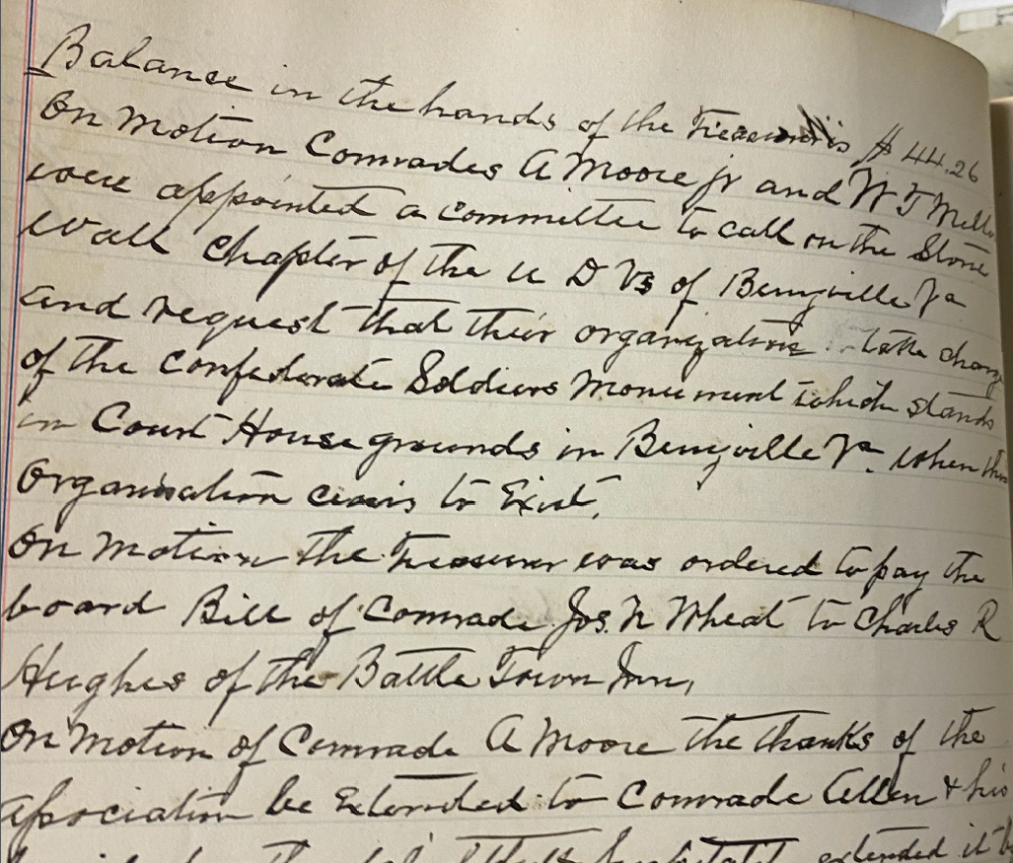

Slide 14
QUESTIONS?

